Slide 1


Team 29: Shoe AR
Bi-Weekly Update 2 Santiago Cantu, Alvaro Espinoza, Ulises Aguilera, Brandon Smith Sponsor: Pranav Dhulipala TA: Eric Robles

Slide 2

Executive Summary
Problem Statement: Shopping for shoes online lacks the in-store benefits of trying on a shoe to ensure the correct size and viewing how the shoe looks on your feet.
Solution Proposal: Create a shoe AR application that measures the size of your foot, provides you the correct shoe size regardless of brand, and allows you to see how the shoe would look on your foot with augmented reality.

Slide 3
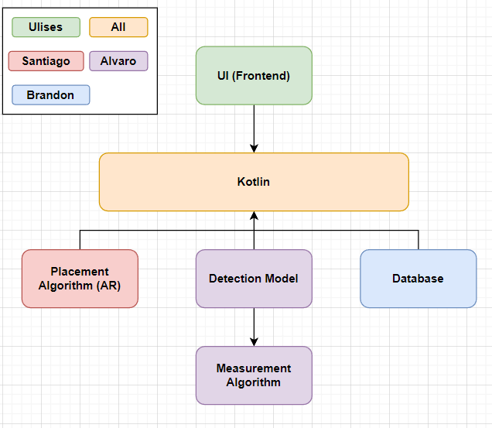
System Block Diagram
UI:​
Storefront
Camera
Kotlin:​​
Information transfer
Database:​
Shoe models
Placement Algorithm:​
Superimposition
Detection Model:
Foot Detection​
Measurement Algorithm:​​
Foot size

Slide 4
Project Timeline
Subsystem Designs and Testing (completed 9/11) | Integration of Database with UI (to complete by 9/28) | Integration of ML Model and AR Camera with UI and Database (to complete by 10/5) | Final Integration (to complete by 10/19) | System Test (to complete by 11/2) | Validation (to complete by 11/26) | Demo and Report (to complete by 12/2)
Notes:
Eric

Slide 5
Shoe Superimposition
Santiago Cantu
Accomplishments since Status Update 1 9 hrs | Ongoing progress/problems and plans until the next presentation
Created basic AR Kotlin App in preparation for integrating with the Frontend | Ongoing research/testing with transforming 3D rendered shoes Ongoing integration with the other subsystems

Slide 6
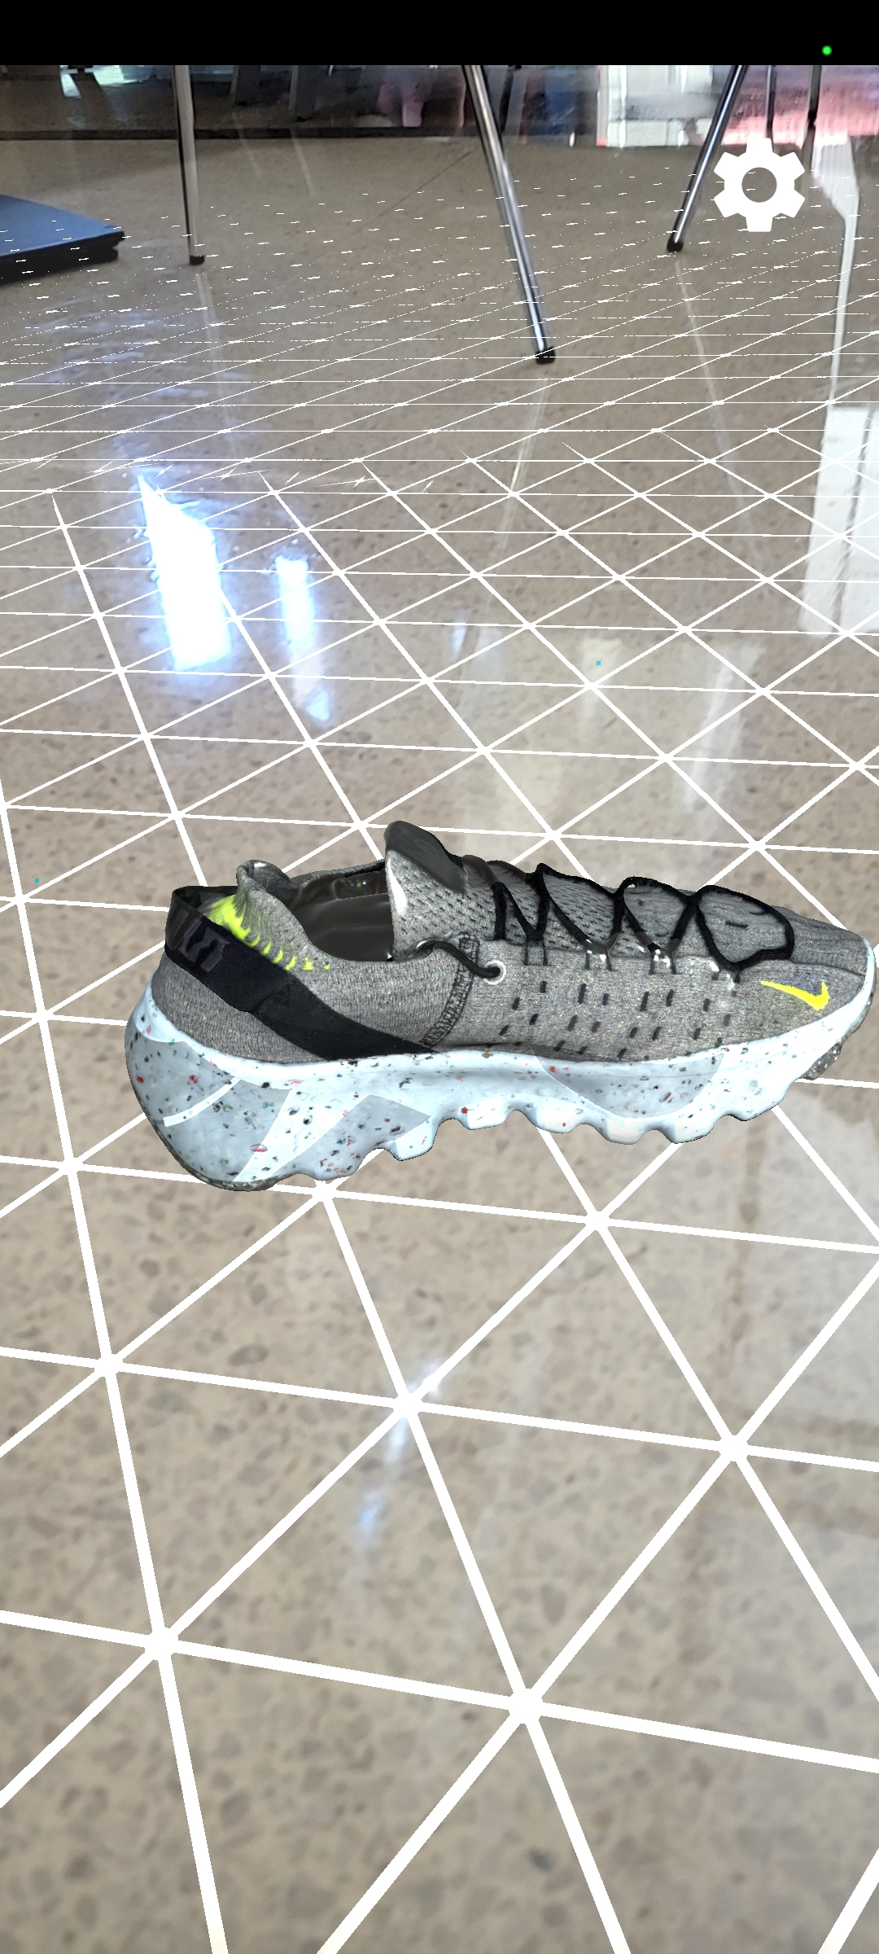
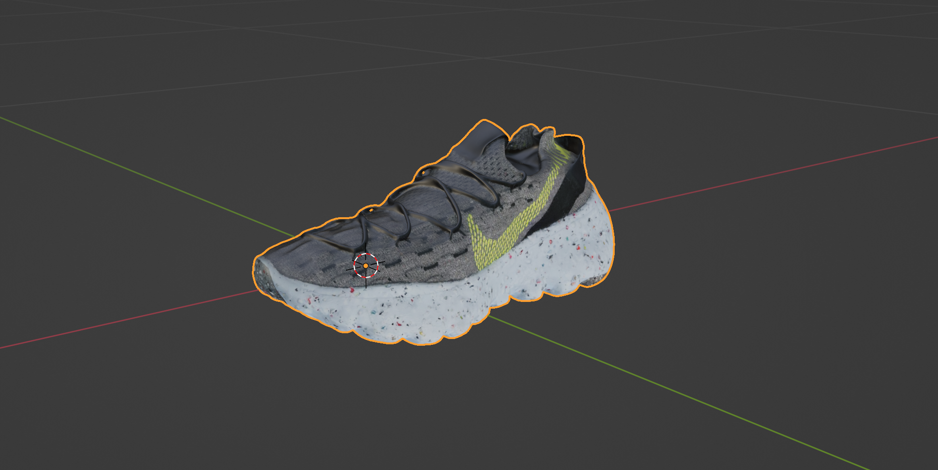
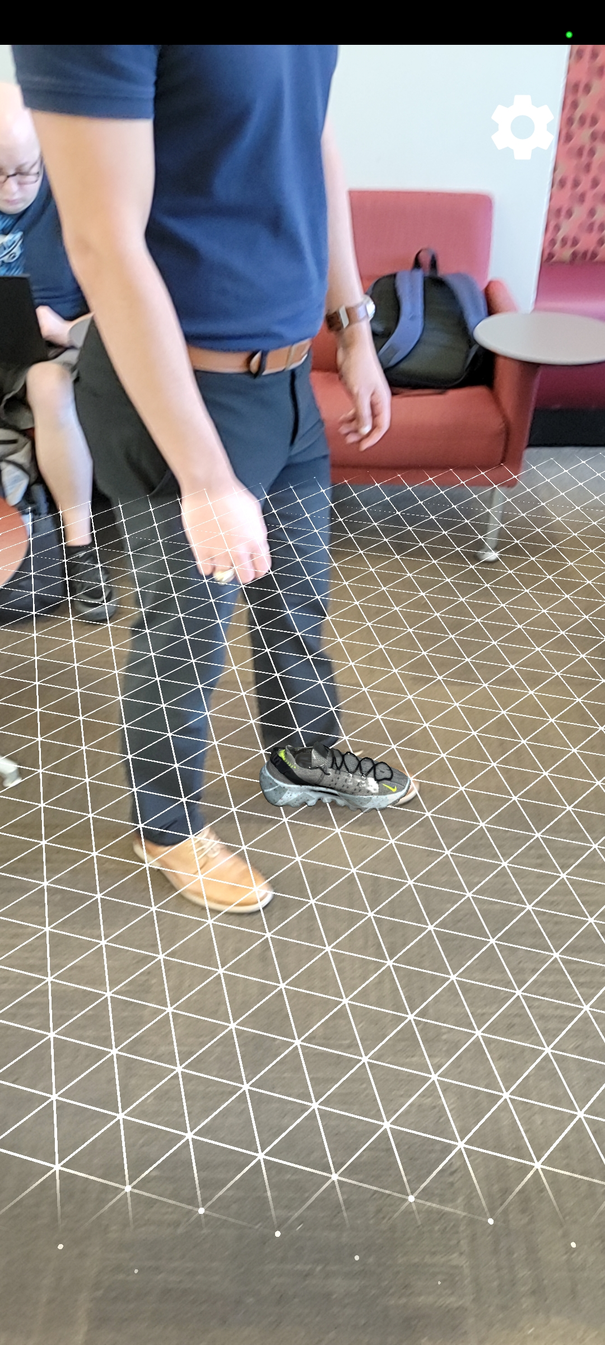
Shoe Superimposition Santiago Cantu

Slide 7
Database/Backend
Brandon Smith
Accomplishments since Status Update 1 14hrs | Ongoing progress/problems and plans until the next presentation
Kotlin unzipping code has been finished Database has been uploaded to Github and integration with the UI has begun | Code Kotlin Room for database to allow for smoother functionality Assist teammates where needed

Slide 8
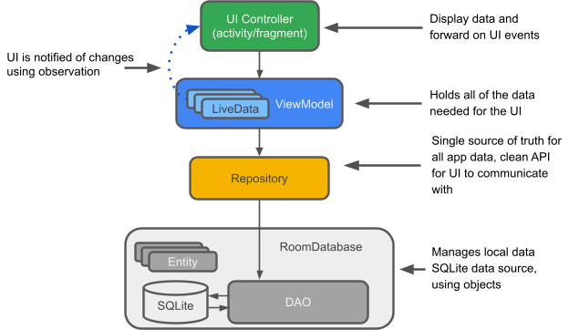
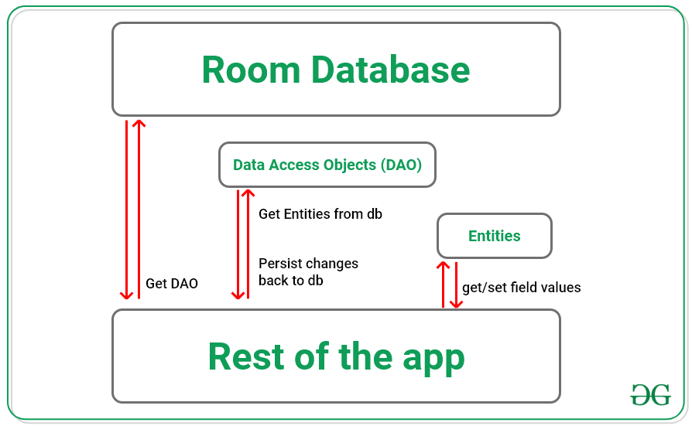
Database/Backend Brandon Smith

Slide 9
Detection Model
Alvaro Espinoza
Accomplishments since Status Update 1 7 hrs | Ongoing progress/problems and plans until the next presentation
Switched to TF Lite Model Maker library Researched example models run on Android emulator Assessed current app build in Kotlin for integration | Finish TFLite conversion Integrate TFLite model into current app build in Kotlin Simulate model in Android emulator

Slide 10
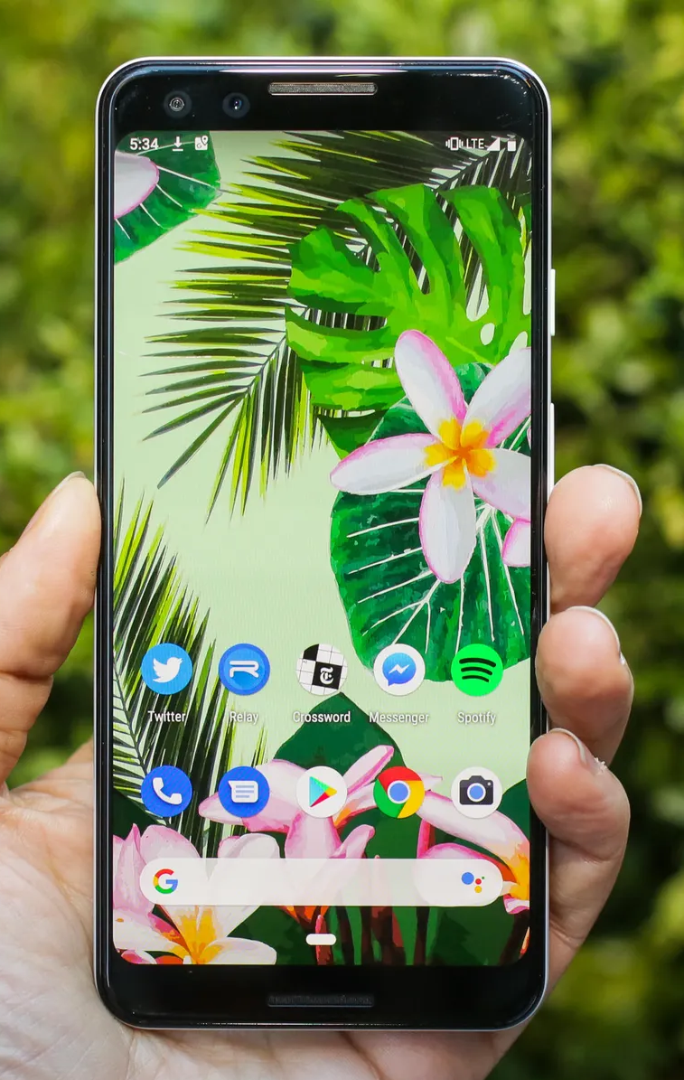



Detection Model Alvaro Espinoza
Model Conversion
Simulation
Deployment

Slide 11
Frontend
Ulises Aguilera
Accomplishments Status Update 1 8hrs | Ongoing progress/problems and plans until the next presentation
Removed Apollo Graph Began integration of DB Worked with Santiago and Alvaro to solidify our integration plan | Complete implementation with DB Begin AR Camera and ML integration

Slide 12
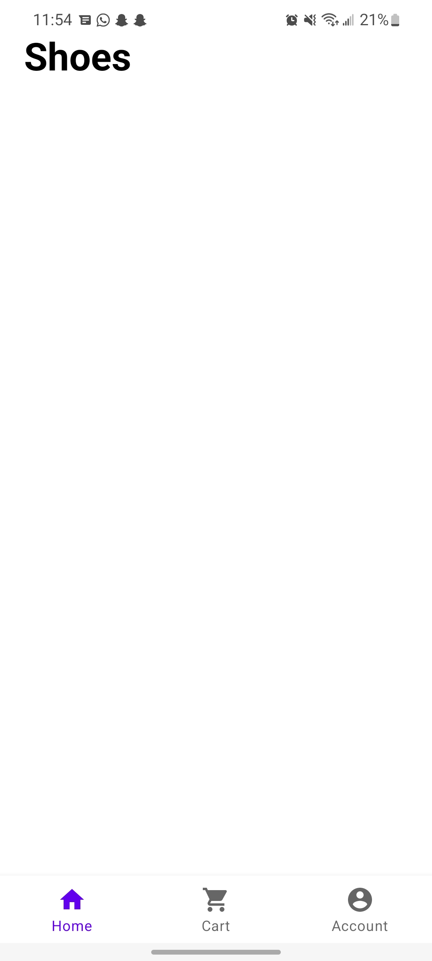
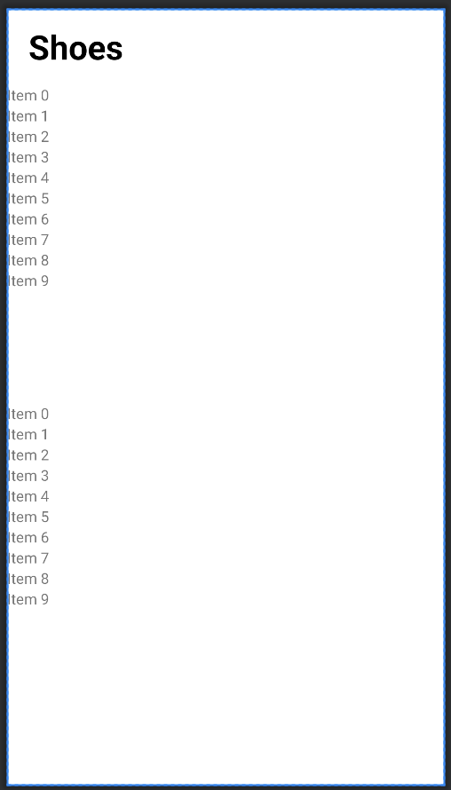
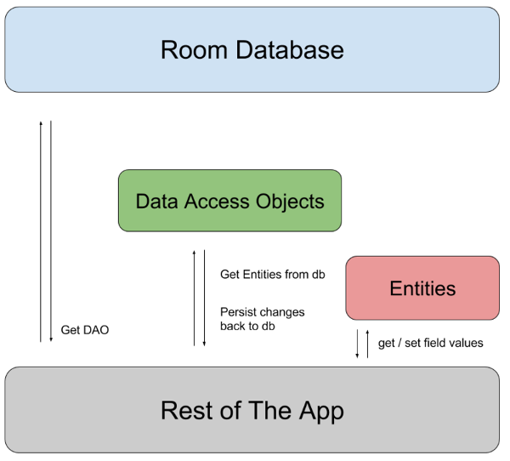
Frontend Ulises Aguilera

Slide 13
Part Ordering Status

Slide 14
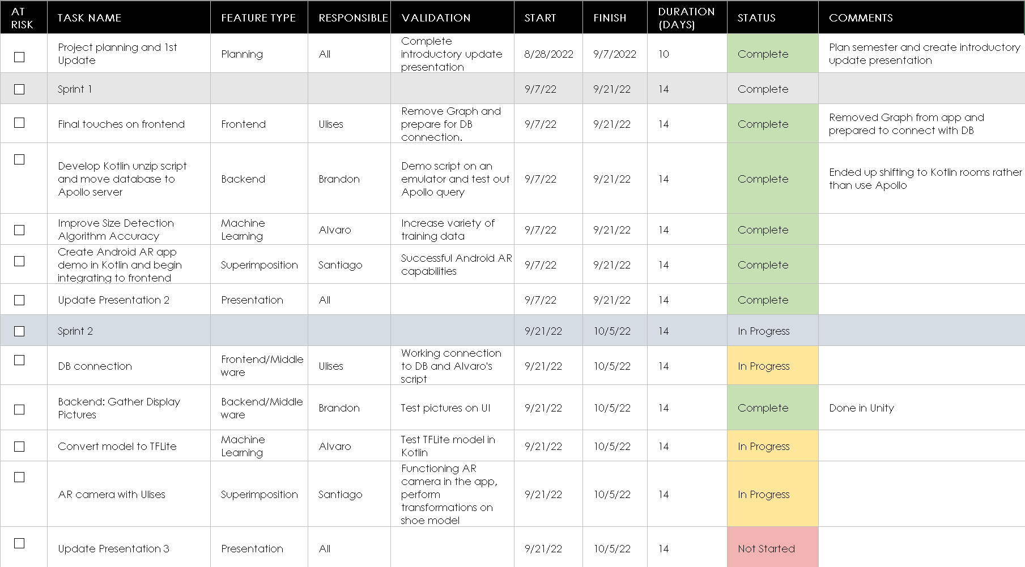
Execution & Validation Plan
Notes:
Michelle

Slide 15
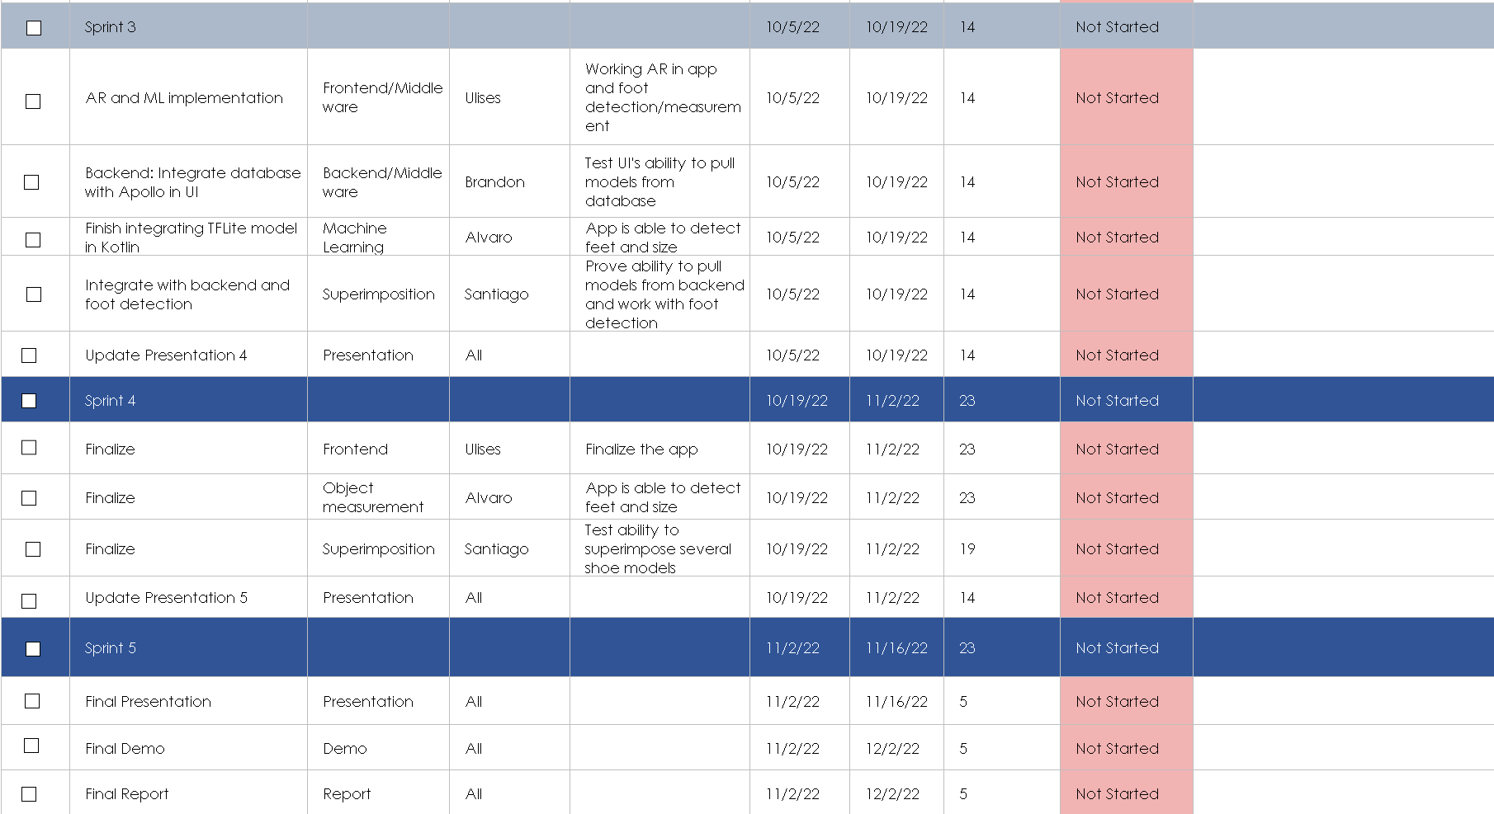
Execution & Validation Plan

Slide 16
Thank you!
Questions?

